Slide 1
Object Detection Using Deep Learning Algorithms (RCNN,FAST RCNN,Faster RCNN)

Slide 2
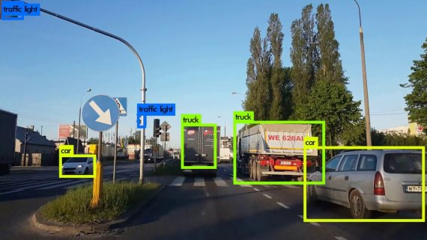
Object detection task-Computer Vision
Computer vision is an interdisciplinary field that has been gaining huge amounts of traction in recent years (since CNN), and self-driving cars have taken center stage.
One of the most important part of computer vision is object detection.
Object detection helps in solving the problem in pose estimation, vehicle detection, surveillance, etc.

Slide 3
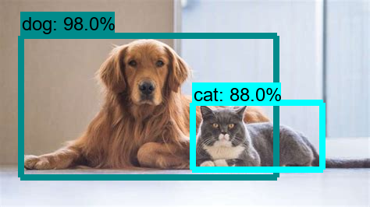
What is Object Detection?

Slide 4
Object Detection Overview
To explore the concept of object detection it is useful to begin with image classification. Image Classification goes through levels of incremental complexity.
Image classification (1) aims at assigning an image to one of a number of different categories (e.g. car, dog, cat, human, etc.), essentially answering the question “What is in this picture?”. One image has only one category assigned to it.
Object localization (2) then allows us to locate our object in the image, so our question changes to “What is it and where it is?”.
In a real real-life scenario, we need to go beyond locating just one object but rather multiple objects in one image.
For example, a self-driving car has to find the location of other cars, traffic lights, signs, humans and to take appropriate action based on this information.
Object detection (3) provides the tools for doing just that – finding all the objects in an image and drawing the so-called bounding boxes around them.
There are also some situations where we want to find exact boundaries of our objects in the process called instance segmentation, but this is a topic for another post.

Slide 5


Slide 6
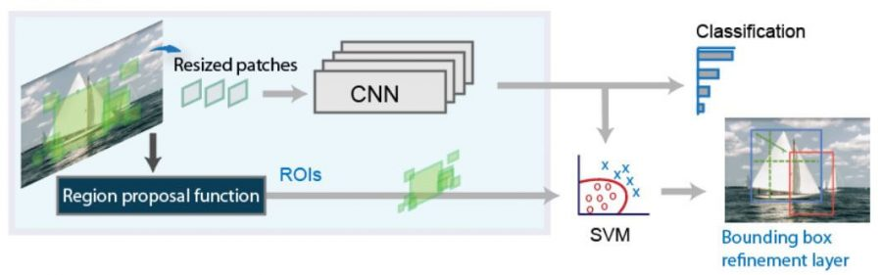
Object Detection Algorithms vs Classification Algorithms
The difference between object detection algorithms and classification algorithms is that in detection algorithms, we try to draw a bounding box around the object of interest to locate it within the image.
With object detection, it is possible to draw many bounding boxes around different objects which represent different objects or may be same objects.

Slide 7
CNN to classify the presence of the object within that region
The main problem with standard convolutional network followed by a fully connected layer is that the size of the output layer is variable — not constant, which means the number of occurrences of the objects appears in the image is not fixed.
A very simple approach to solving this problem would be to take different regions of interest from the image and use a CNN to classify the presence of the object within that region.

Slide 8
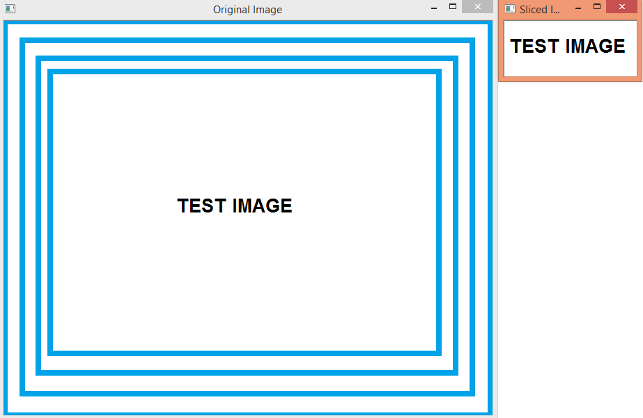
Region of Interest
In some cases, it might make sense to only apply some type of operation only to a portion of an image. Thus, it is important to understand how we can extract a region of interest of an original image.
Note that we are not going to apply any sort of algorithm to extract parts of an image that have some special feature, but rather simply define a part of the image that we want to obtain by specifying the coordinates of that region.

Slide 9
Object Detection vs. Object Recognition
An object recognition algorithm identifies which objects are present in an image. It takes the entire image as an input and outputs class labels and class probabilities of objects present in that image.
For example, a class label could be “dog” and the associated class probability could be 97%.
On the other hand, an object detection algorithm not only tells you which objects are present in the image, it also outputs bounding boxes (x, y, width, height) to indicate the location of the objects inside the image.
At the heart of all object detection algorithms is an object recognition algorithm.
Suppose we trained an object recognition model which identifies dogs in image patches. This model will tell whether an image has a dog in it or not. It does not tell where the object is located.
To localize the object, we have to select sub-regions (patches) of the image and then apply the object recognition algorithm to these image patches. The location of the objects is given by the location of the image patches where the class probability returned by the object recognition algorithm is high.

Slide 10
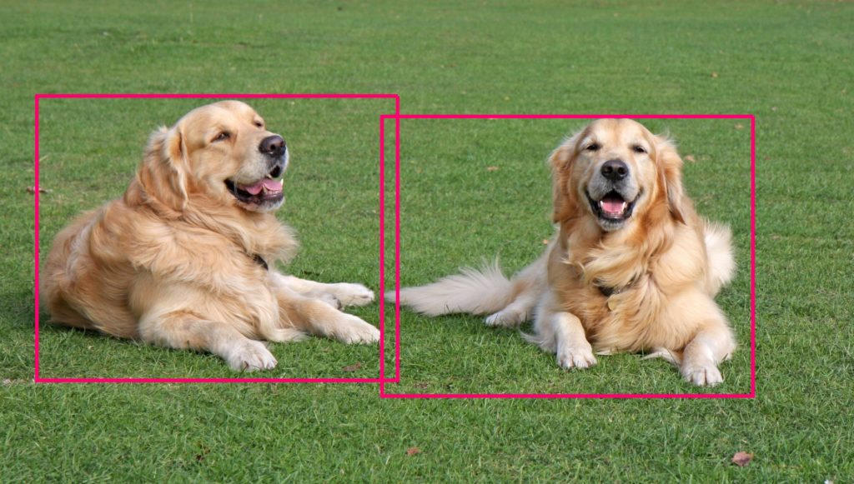
Object Detection vs. Object Recognition

Slide 11
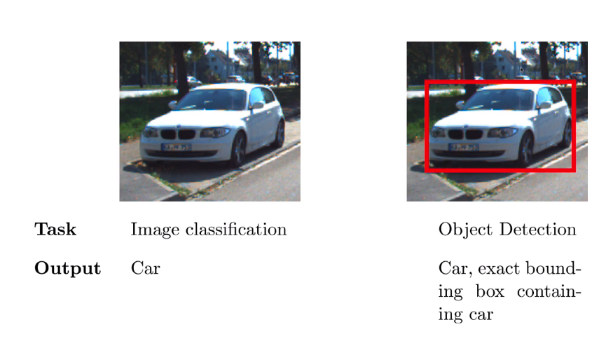
Image Classification and Detection
In Image Classification, we are given an image and the model predicts the class label for example for the above image as the input, model would predict that this is a car i.e the input is an image and the output is a class label whereas in the case of Object Detection the input is an image and the output is the label Car as well as the exact bounding box containing car.

Slide 12
Sliding Window Algorithm
In the sliding window approach, we slide a box or window over an image to select a patch and classify each image patch covered by the window using the object recognition model.
It is an exhaustive search for objects over the entire image.
Not only do we need to search all possible locations in the image, we have to search at different scales.
This is because object recognition models are generally trained at a specific scale (or range of scales).
This results into classifying tens of thousands of image patches.

Slide 13
Sliding Window Algorithm
The most straightforward way to generate smaller sub-regions (patches) is called the Sliding Window approach.
However, the sliding window approach has several limitations.
These limitations are overcome by a class of algorithms called the “Region Proposal” algorithms.
Selective Search is one of the most popular Region Proposal algorithms.

Slide 14
Region Proposal Algorithms
The problems we have discussed so far can be solved using region proposal algorithms.
These methods take an image as the input and output bounding boxes corresponding to all patches in an image that are most likely to be objects.
These region proposals can be noisy, overlapping and may not contain the object perfectly but amongst these region proposals, there will be a proposal which will be very close to the actual object in the image.
We can then classify these proposals using the object recognition model.
The region proposals with the high probability scores are locations of the object.

Slide 15
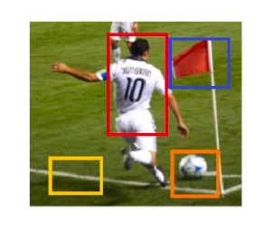
Object Detection
In the image goal is to identify all objects in it, we can see that there are 3 objects, there is this person, then there is a flag and then there is a ball and the other yellow bounding box there is no object over there, there is nothing in that region so the model should be able to identify/say that as well.

Slide 16
Region Proposal Phase
Regional Proposal Phase is one stage in the pipeline where some regions in the image are proposed as the regions which might contain the object.
Here in the above image, we have shown only 4 regions but in actual practice, there would be many more regions of different shapes, sizes and aspect ratio:
These are the regions where there might be an object, so it tries to predict whether the proposed regions actually contains an object and if so what is the class/label of the object.
Once the regions are proposed, then we will crop out(we give the co-ordinates of the lower-left corner and the width and the height of rectangle based on which it will crop this region from the input image and make a new image; so all of the regions/images would be cropped to the same size(let’s say this size is p, q)) each of these regions.
Now from these cropped images, we need to do some sort of feature extractions.

Slide 17
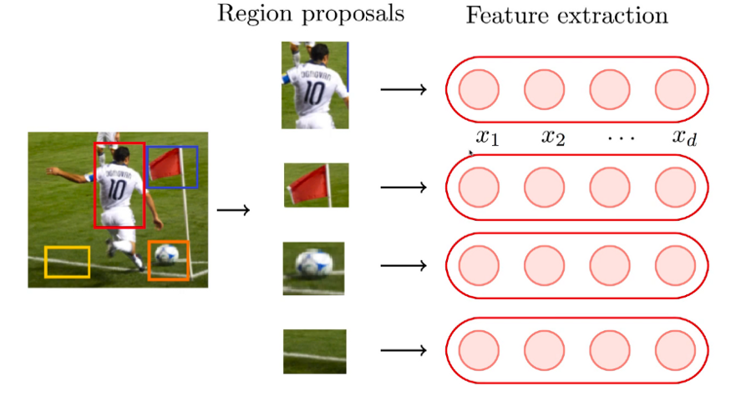

Slide 18
Let’s say we crop all the images to be of the size 30 X 30 so ‘d’ is 30(30-dimensional vector) in this case and each of the cropped images would then be a 900-dimensional vector(30 X 30 vector/matrix when flattened out) and we want to do the classification on that.
Our input ‘x’ in this case would be a vector containing 900 values and the output ‘y’ could be any of the class out of the total no. of classes let’s say total 4 classes are there so y could be Class A, Class B, …, Class D.
We could do this classification using one layer neural network or a deep neural network or using a CNN as well.

Slide 19
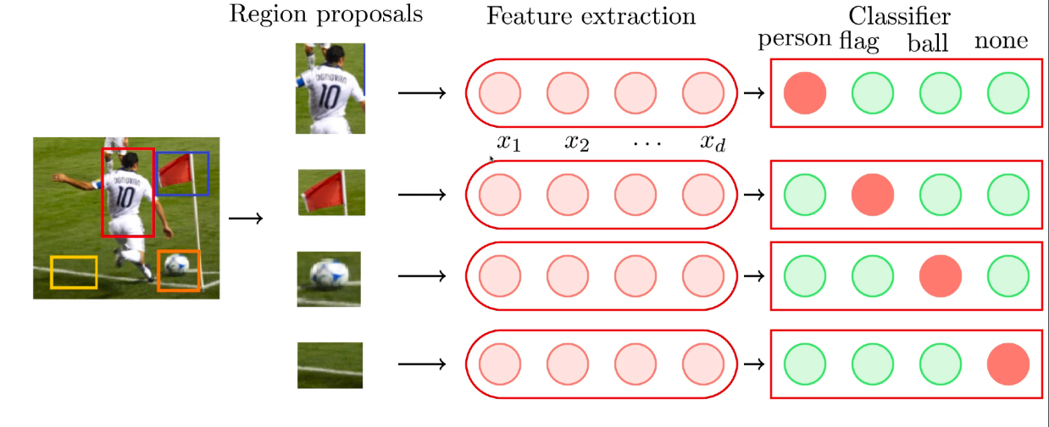
Classification

Slide 20
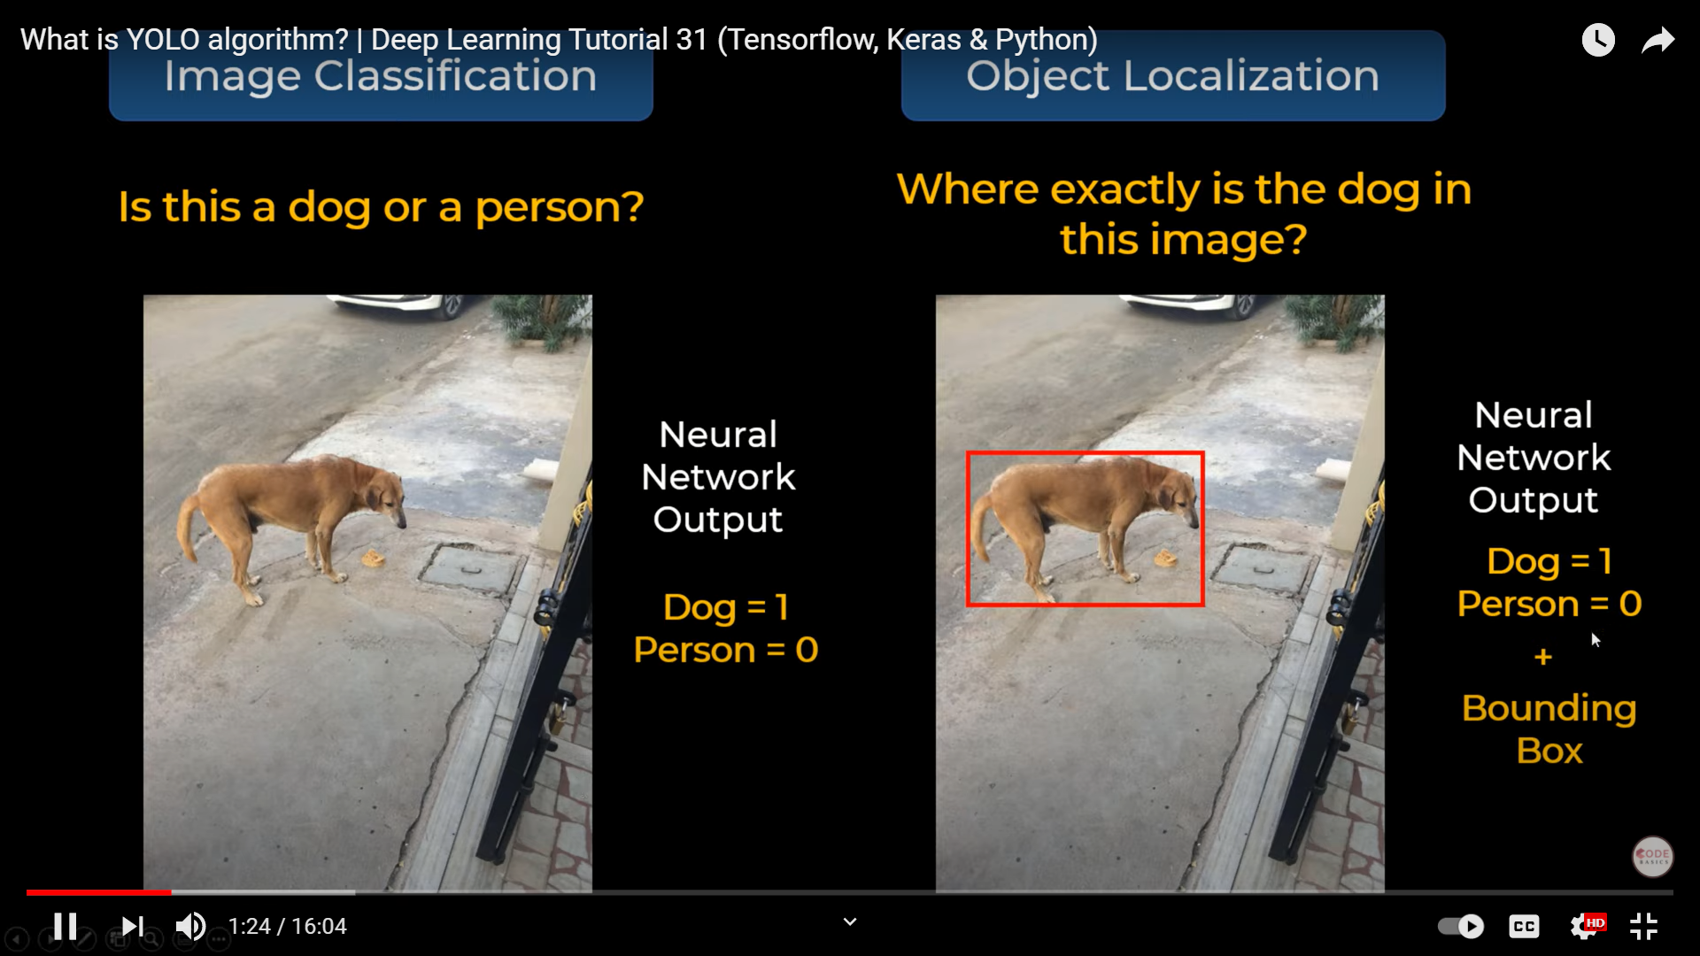

Slide 21
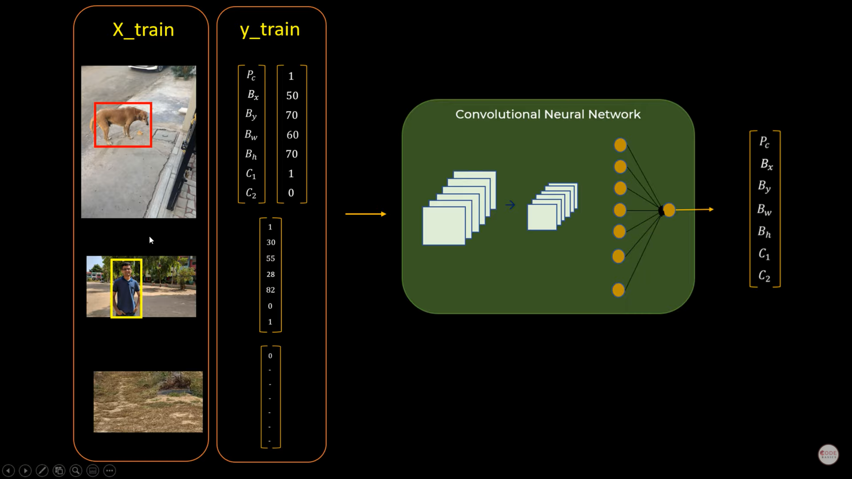

Slide 22
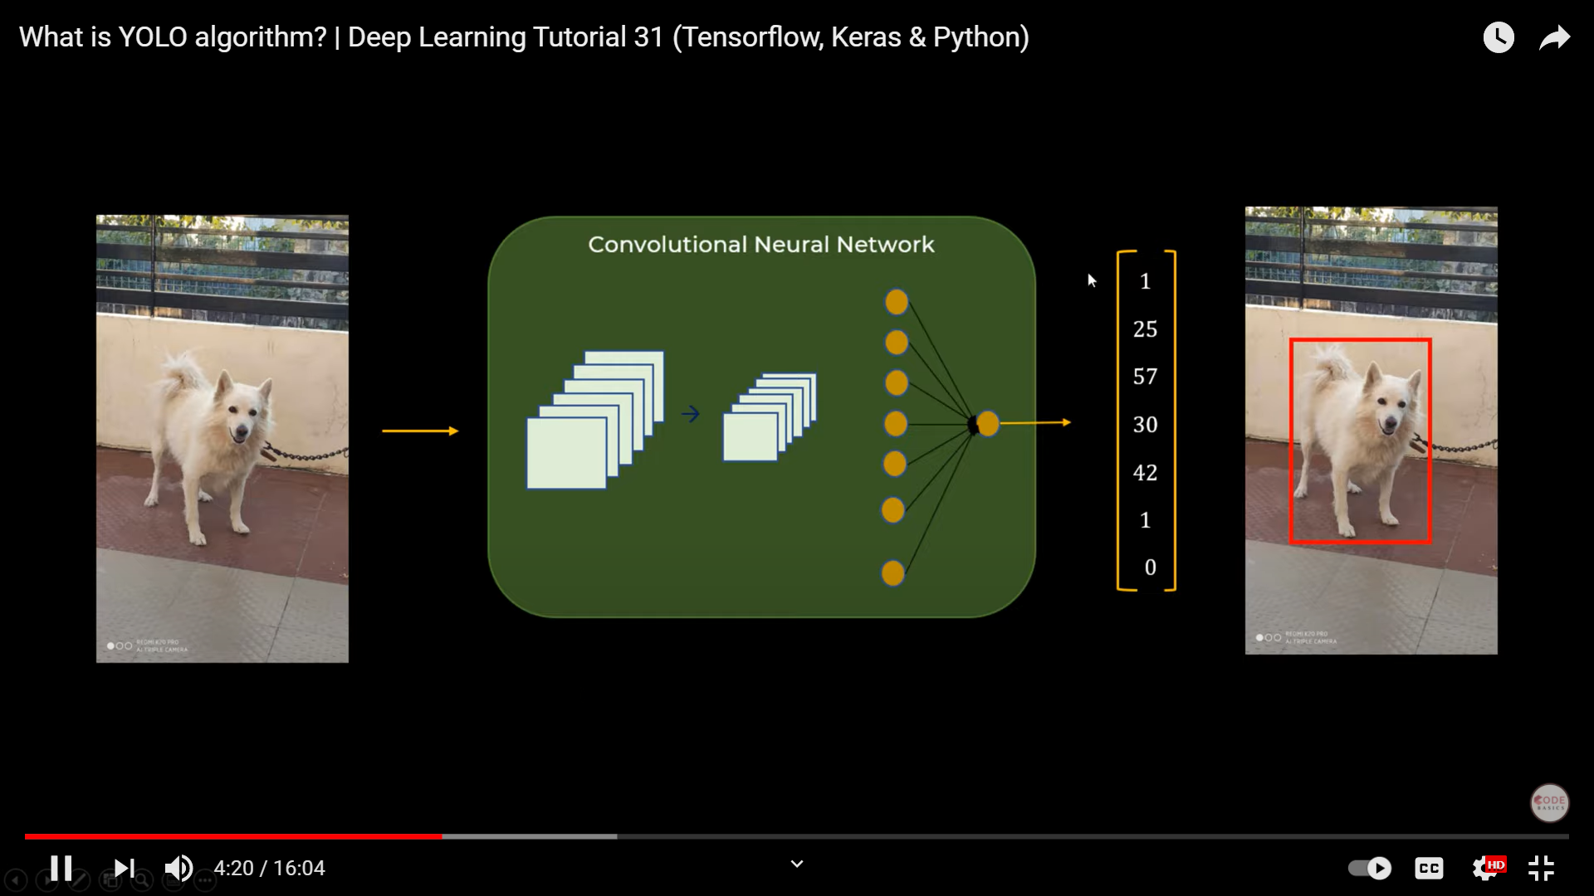
One object in Image

Slide 23
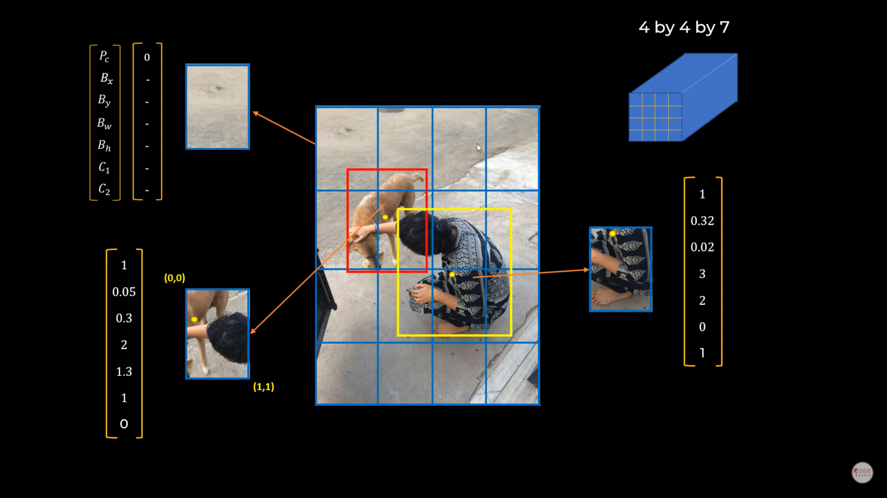

Slide 24
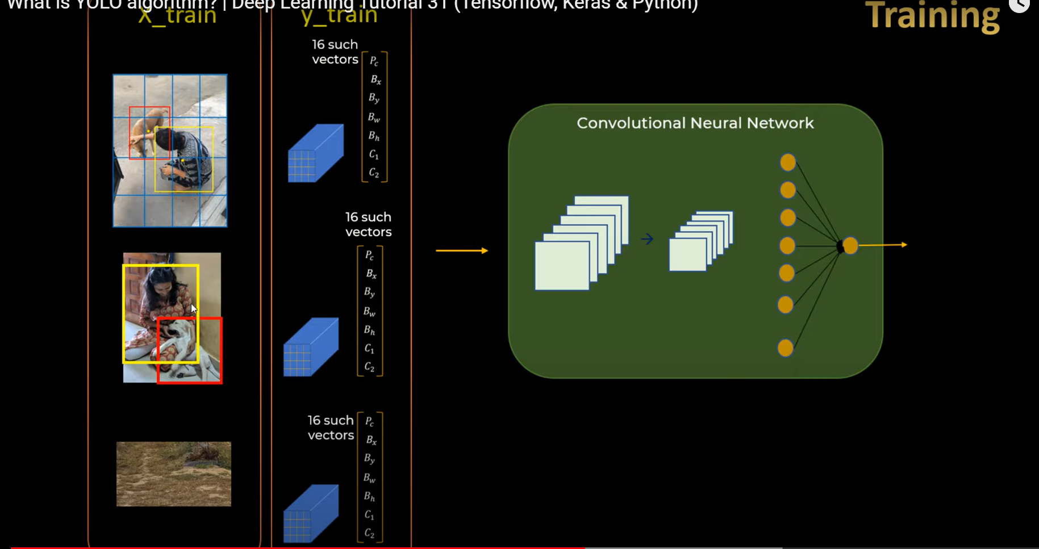

Slide 25
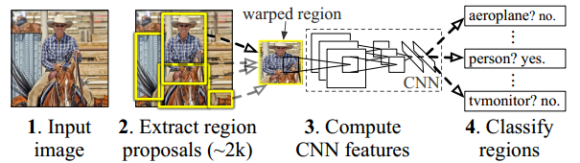
RCNN
The R-CNN paper[1] was published in 2014. It was the first paper to show that CNN can lead to high performance in object detection. This algorithm does object detection in the following way:

Slide 26
RCNN Steps
The method takes an image as input and extracts around 2000 region proposals from the image(Step 2 in the above image).
Each region proposal is then warped(reshaped) to a fixed size to be passed on as an input to a CNN.
The CNN extracts a fixed-length feature vector for each region proposal(Step 3 in the above image).
These features are used to classify region proposals using category-specific linear SVM(Step 4 in the above image).
The bounding boxes are refined using bounding box regression so that the object is properly captured by the box.

Slide 27
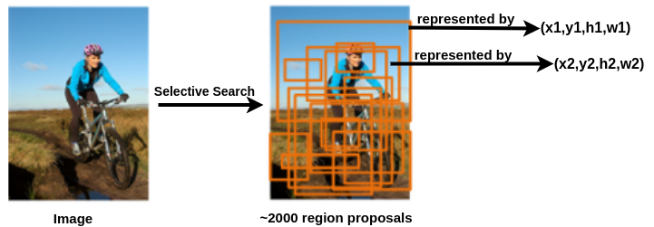
Calculating region Proposals
Regino proposals are the bounding boxes that may contain an object. These are represented by a tuple of 4 numbers(x,y,h,w).
The (x,y) are the coordinates of the centre of the bounding box and (h,w) are the height and width of the bounding box respectively.
These region proposals are calculated by an algorithm called selective search[2]. For an image, approximately 2000 region proposals are extracted.

Slide 28
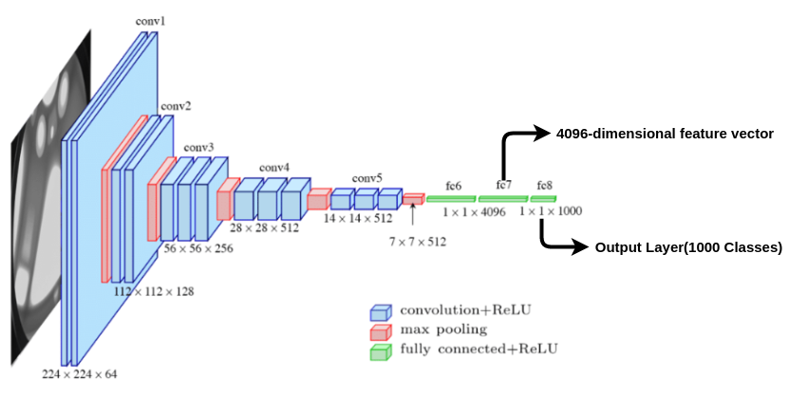
Training CNN feature extractor:

Slide 29
Pretrained network:
To train the CNN for feature extraction, an architecture like VGG-16 is initialized with the pre-trained weights from imagenet data.
The output layer having 1000 classes is chopped off. So when a region proposal image(warped to size 224x224) is passed to the network we get a 4096-dimensional feature vector as shown in the above image. In this way, each region proposal is represented by a 4096-dimensional feature vector.
The next step is to fine-tune the weights of the network with the region proposal images. To understand this a new metric called intersection-over-union or IoU score will be introduced.

Slide 30
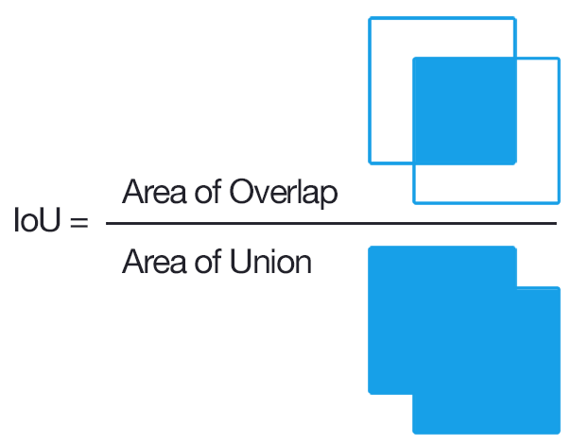
Intersection-Over-Union(IoU)
To measure the performance of a classification model, we generally use metrics like accuracy, recall, precision etc. But how to measure the performance of object detection.
In object detection we have to evaluate two things:
How well the bounding box can locate the object in the image. In other words, how close the predicted bounding box is to the ground truth.
Whether the bounding box is classifying the enclosed object correctly

Slide 32
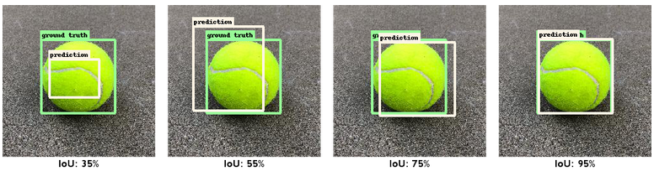
Intersection-Over-Union(IoU)
The IoU score measures how close the predicted box is to the ground truth. It is the ratio of the area common to ground truth and predicted box to the total area enclosed by both the boxes.
In the left-most image, it can be seen that the predicted box is not close to the ground truth so the IoU score is only 35% while in the right-most image the predicted box completely overlaps the ground truth box, hence a very high value of 95% is obtained. The IoU value varies from 0 to 1.

Slide 34
Fine-tuning the network
Fine-tuning the network: To fine-tune the model the output layer having 1000 classes is replaced with N+1 classes(softmax layers) and the rest of the model is kept unchanged. N is the number of the distinct classes the objects be classified and plus 1 for the background class.
Next, data is required for fine-tuning. The region proposals whose IoU > 50% are considered a positive class for that object and rest are considered as background. In the above image of balls, the region proposal with 35% IoU score will be labelled as background while the rest of the boxes will be labelled as ball. These images(region proposals) are warped(resized) to the size compatible with CNN, in case of VGG 16 it is 224x224. Using these images the weights of the network are fine-tuned.

Slide 35
Training class-specific SVM
Training class-specific SVM
Once the 4096-dimensional feature is obtained for each region proposal, the next task is to train a binary SVM for each class. For example, if the detection model is to detect three distinct objects — cat, dog and people, then three SVMs need to be trained for each of the class.
Data preparation: All the object proposals belonging to a particular class is segregated. The manually labelled ground truth image for the class is considered as a positive class while object proposals having IoU < 30% for that class is considered as negative class. The same thing is done for each class and N SVM models are trained for classifying each region proposal into N classes.

Slide 36
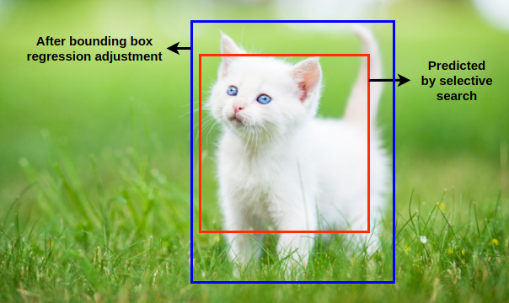
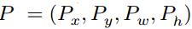
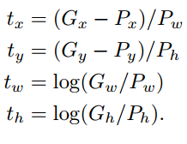
Bounding box regression
The region proposal bounding box predicted by selective search[2] algorithm might not be able to capture the entire object. To fine-tune the predicted bounding box, bounding box regression is used.Consider the ground truth region proposal G and the predicted region proposal P by the selective search[2] algorithm.
To make the prediction of G scale-invariant, the following transformations are done such that the target for the regression is t.

Slide 37
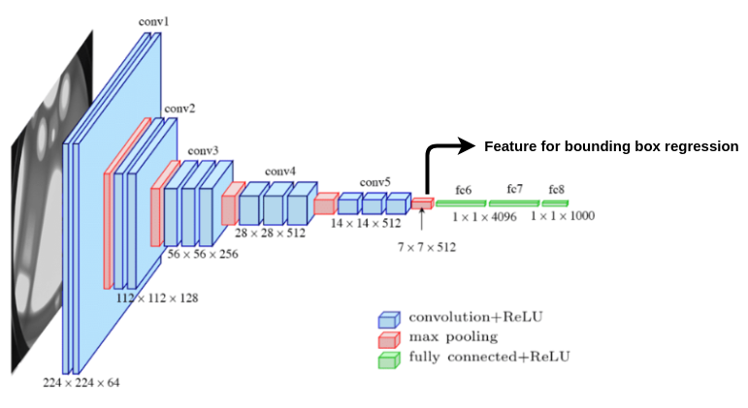

Slide 38
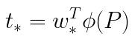
Regression Equation
The input to the regression model is the feature from the last pooling layer of the CNN. We train 4 regression models per class with the target as t and input features as last pooling layer feature from CNN to learn regression parameter w.
Here * is the placeholder for (x,y,w,h) and phi(P) is the last pooling layer feature corresponding to proposal P. So to predict ground truth G we can use the regression equation to calculate t from the region proposal P and then substitute the value of t and P in transformation equation to obtain G.

Slide 39
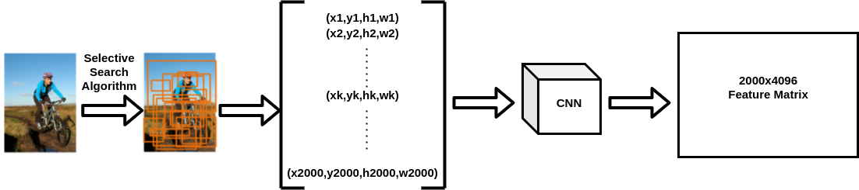
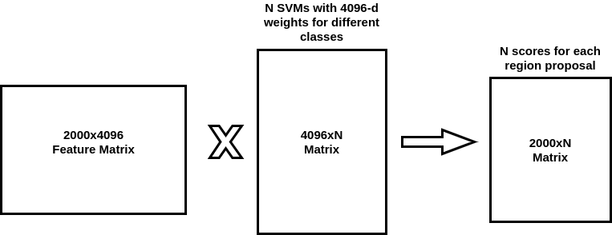

Slide 40
An input image is taken and using selective search[2] algorithm, around 2000 region proposals are obtained for an image.
Each region proposal image is warped to a fixed size of 224x224.
These region proposal images are then passed to the trained CNN to obtain 4096-dimensional feature vector for all the 2000 region proposals which result in 2000x4096 dimensional matrix.
Each region proposal is classified using SVM for each class. generally for N classes, the SVM weights(4096-dimensional) are stacked in the form of a matrix and multiplied with the feature matrix. This results in a matrix which assigns a score to each class to which a region proposal can belong to.
The proposal is assigned the class which receives the maximum score. So all the 2000 region proposals or bounding boxes in the image are labelled with a class label.
Out of those many bounding boxes, a lot of them would be redundant and overlapping bounding boxes which need to be removed. To accomplish that Non-maximum suppression algorithm is used.
Once the labelled bounding boxes are obtained the next task is to fine-tune the location of the boxes using regression.

Slide 41
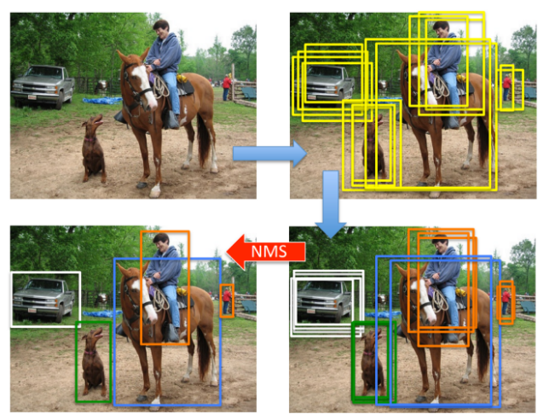
Non-maximum suppression algorithm:
Non-maximum suppression is a greedy algorithm. It works on one class at a time.
For a particular class, it picks the box with the maximum score obtained using SVM. T
hen it calculates IoU score with all other bounding boxes belonging to that class.
The boxes having IoU score greater than 70% are removed.
In other words, the bounding boxes which have very high overlap are removed.
Then the next highest score box is chosen and so on until all the overlapping bounding boxes are removed for that class.

Slide 42
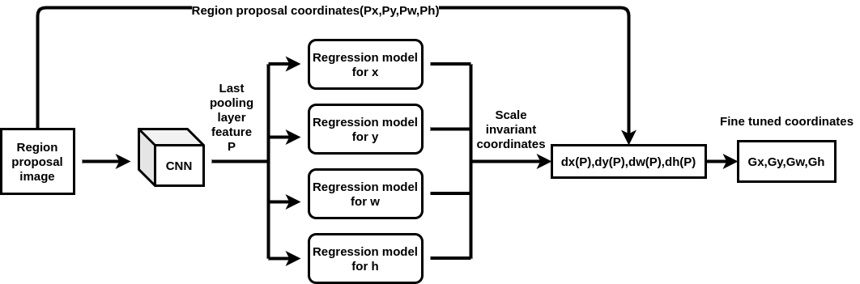
Fine-tuning region proposals through regression

Slide 43
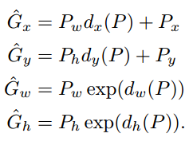
During training,4 regression models were trained for each class.
So for a particular bounding box, region proposal image is passed through CNN to obtain features P to be passed to the regression model.
The regression model outputs the scale-invariant coordinates ( dx(P), dy(P), dw(P), dh(P) ). These coordinates are combined with the region proposal coordinates ( Px, Py, Pw, Ph ) to obtain the adjusted final coordinates ( Gx, Gy, Gw, Gh) using the formula below.

Slide 44
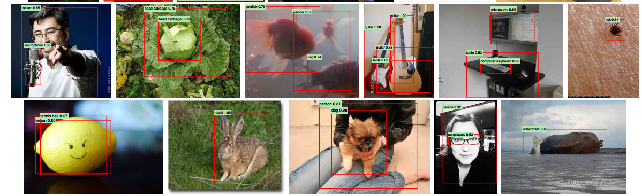
The result from the original paper

Slide 45
RCNN uses Selective Search for Region Proposals
Given an image, we can do clustering(clustering is a simple technique in which the similar objects are put into the same cluster). So, if we look at the above image, there is this green patch(grass), that entire patch could be one cluster:
Then it has this entire white region here(where the sheep is), that could be one cluster:
The person is wearing some shirt or jacket, based on that it could be one cluster:
This would be a simple technique because these pixels would have the same color and texture(we can use OpenCV for doing this) and there would be some threshold, so if the similarity between two regions is above some threshold then we make them into one cluster. That’s exactly what this Selective Search does.

Slide 46
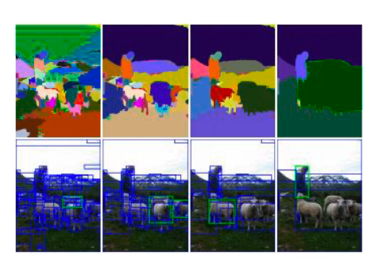

Slide 47
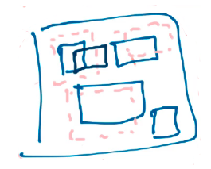
Regression Stage: We run the Selective Search on all the training data that we have and we get the proposed regions/boxes(coordinates) and for the same data we have the True boxes/coordinates, using these coordinates we try to find the normalized difference between the true coordinates and the proposed coordinates.
Because selective search does the clustering at different levels, so it might be the case that both boxes(overlapping blue and black boxes in the below image) might come up in the proposal by the selective search
So, the question is what we take as the proposed box here and the true box here because both these proposed boxes are overlapping with the same pink box, so the way we deal with this is that we compute the overlap between the proposed box and the true box and if the overlap is more than 50% then we consider this as the proposed box; then we take this proposed box and try to map it with the corresponding true box and train our model to do that.

Slide 48
A drawback of RCNN:
One drawback of RCNN is that the number of computations are very high, for each input image, it would propose some 2000 regions and then for each of the region we crop it and resize it then do the classification and regression task on it.
So, it is computationally expensive.

Slide 49
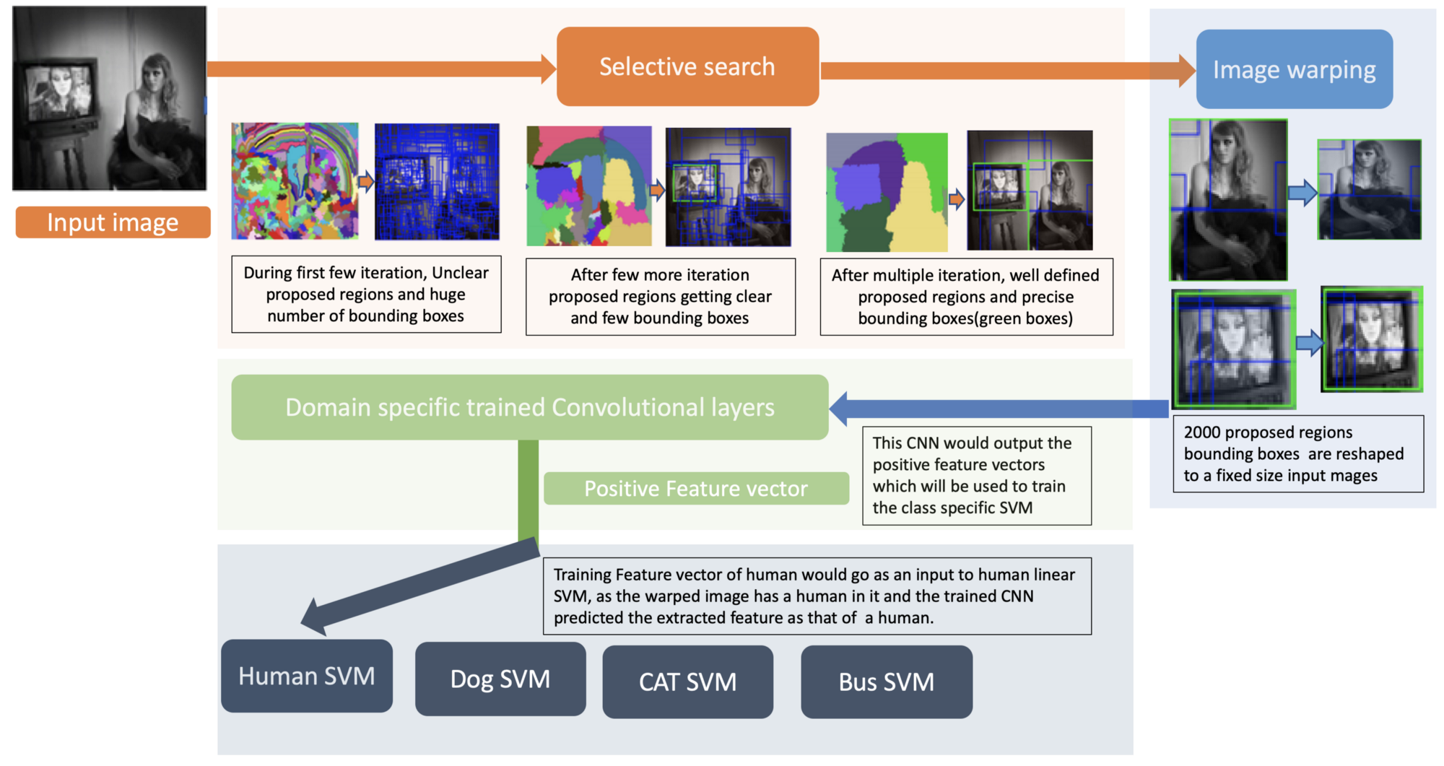

Slide 50
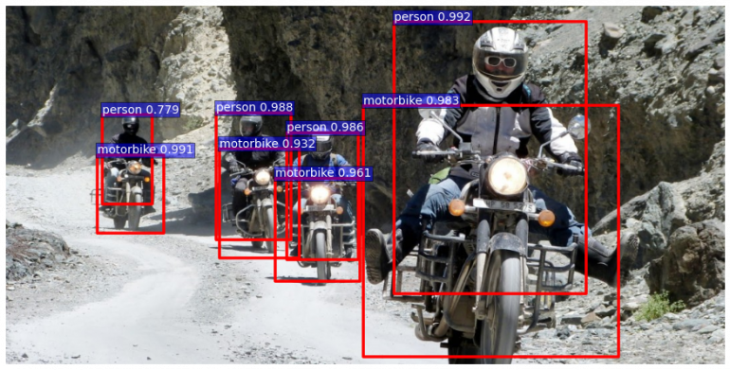

Slide 51
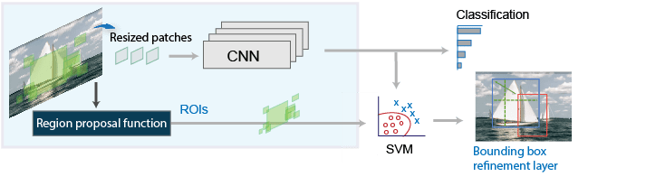
R-CNN
The R-CNN detector first generates region proposals using an algorithm such as Edge/bounding Boxes.
The proposal regions are cropped out of the image and resized.
Then, the CNN classifies the cropped and resized regions.
Finally, the region proposal bounding boxes are refined by a support vector machine (SVM) that is trained using CNN features.

Slide 52
Problems with RCNN
So far, we’ve seen how RCNN can be helpful for object detection. But this technique comes with its own limitations. Training an RCNN model is expensive and slow thanks to the below steps:
Extracting 2,000 regions for each image based on selective search
Extracting features using CNN for every image region. Suppose we have N images, then the number of CNN features will be N*2,000
The entire process of object detection using RCNN has three models:
CNN for feature extraction
Linear SVM classifier for identifying objects
Regression model for tightening the bounding boxes.
All these processes combine to make RCNN very slow. It takes around 40-50 seconds to make predictions for each new image, which essentially makes the model cumbersome and practically impossible to build when faced with a gigantic dataset.

Slide 53
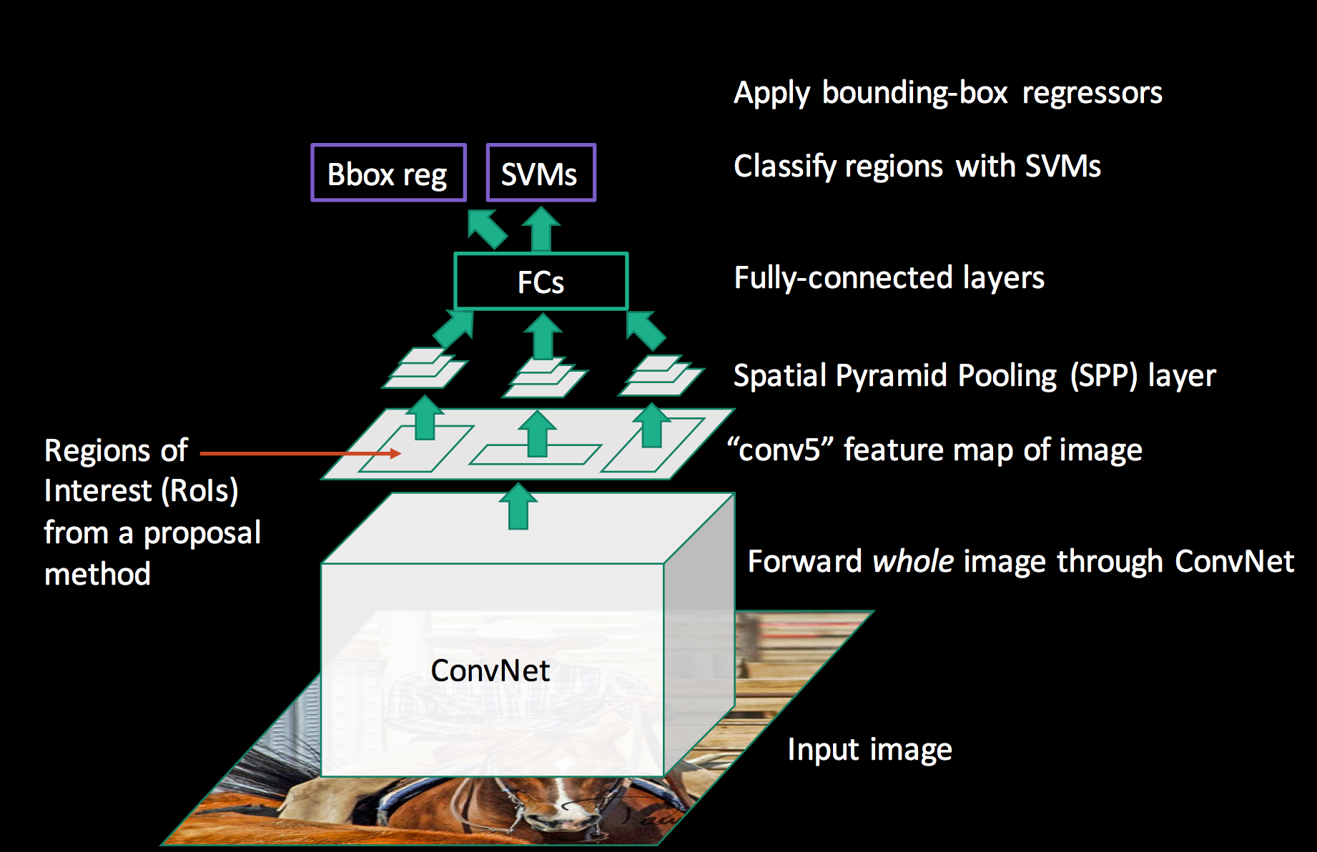
RCNN

Slide 54
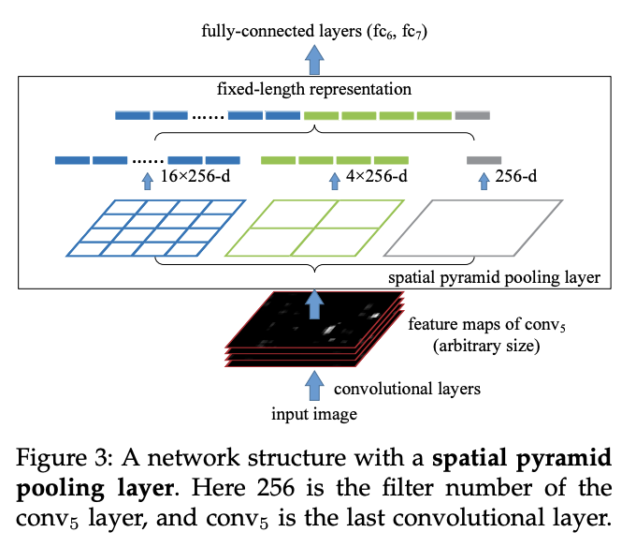
Spatial Pyramid Pooling
Spatial Pyramid Pooling (SPP) is a pooling layer that removes the fixed-size constraint of the network, i.e. a CNN does not require a fixed-size input image.
Specifically, we add an SPP layer on top of the last convolutional layer.
The SPP layer pools the features and generates fixed-length outputs, which are then fed into the fully-connected layers (or other classifiers).
In other words, we perform some information aggregation at a deeper stage of the network hierarchy (between convolutional layers and fully-connected layers) to avoid the need for cropping or warping at the beginning.

Slide 55
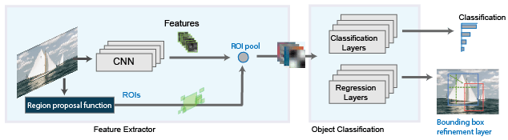
Fast R-CNN
Ross Girshick, the author of RCNN, came up with this idea of running the CNN just once per image and then finding a way to share that computation across the 2,000 regions. In Fast RCNN, we feed the input image to the CNN, which in turn generates the convolutional feature maps. Using these maps, the regions of proposals are extracted. We then use a Roi pooling layer to reshape all the proposed regions into a fixed size, so that it can be fed into a fully connected network.

Slide 56
Fast R-CNN Pipeline-Architecture details:
To better understand how and why the Fast R-CNN improved efficiency and performance of R-CNN and SPP Networks, let’s first look into its architecture.
The Fast R-CNN consists of a CNN (usually pre-trained on the ImageNet classification task) with its final pooling layer replaced by an “ROI pooling” layer and its final FC layer is replaced by two branches — a (K + 1) category softmax layer branch and a category-specific bounding box regression branch.

Slide 57
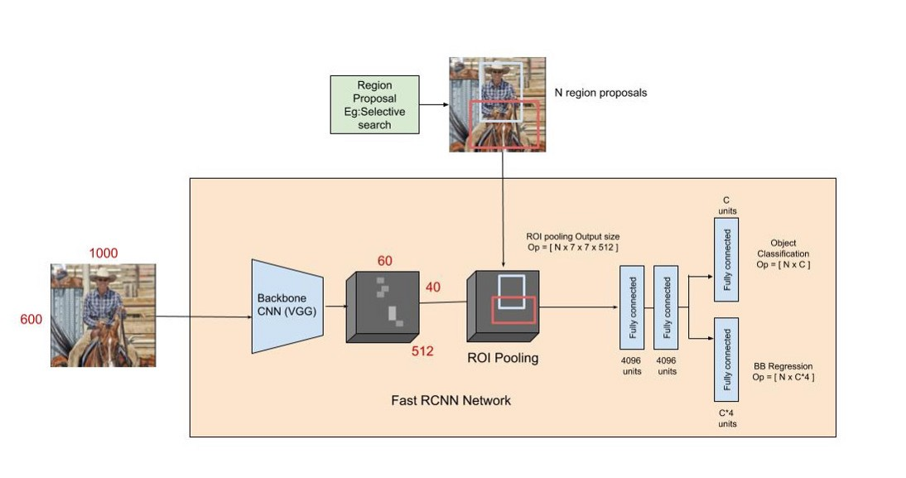
The Fast R-CNN pipeline

Slide 58
Fast RCNN Steps
The entire image is fed into the backbone CNN and the features from the last convolution layer are obtained.
Depending on the backbone CNN used, the output feature maps are much smaller than the original image size. This depends on the stride of the backbone CNN, which is usually 16 in the case of a VGG backbone.
Meanwhile, the object proposal windows are obtained from a region proposal algorithm like selective search.
As explained in Regions with CNNs, object proposals are rectangular regions on the image that signify the presence of an object.

Slide 59
Fast RCNN Steps
3. The portion of the backbone feature map that belongs to this window is then fed into the ROI Pooling layer.
The ROI pooling layer is a special case of the spatial pyramid pooling (SPP) layer with just one pyramid level.
4. The layer basically divides the features from the selected proposal windows (that come from the region proposal algorithm) into sub-windows of size h/H by w/W and performs a pooling operation in each of these sub-windows.
This gives rise to fixed-size output features of size (H x W) irrespective of the input size. H and W are chosen such that the output is compatible with the network’s first fully-connected layer. The chosen values of H and W in the Fast R-CNN paper is 7.
Like regular pooling, ROI pooling is carried out in every channel individually.
5. The output features from the ROI Pooling layer (N x 7 x 7 x 512 where N is the number of proposals) are then fed into the successive FC layers, and the softmax and BB-regression branches.
6. The softmax classification branch produces probability values of each ROI belonging to K categories and one catch-all background category. The BB regression branch output is used to make the bounding boxes from the region proposal algorithm more precise.

Slide 60
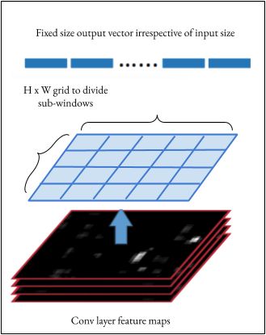
Region of interest pooling
Region of interest pooling is a neural-net layer used for object detection tasks. It also maintains a high detection accuracy. The layer takes two inputs:
A fixed-size feature map obtained from a deep convolutional network with several convolutions and max pooling layers.
An N x 5 matrix of representing a list of regions of interest, where N is a number of RoIs. The first column represents the image index and the remaining four are the coordinates of the top left and bottom right corners of the region.
The ROI pooling layer as a special case of SPP layer

Slide 61
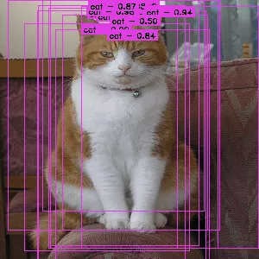
What does the RoI pooling actually do?
For every region of interest from the input list, it takes a section of the input feature map that corresponds to it and scales it to some pre-defined size (e.g., 7×7). The scaling is done by:
Dividing the region proposal into equal-sized sections (the number of which is the same as the dimension of the output)
Finding the largest value in each section
Copying these max values to the output buffer

Slide 62
ROI Pooling Significances
The result is that from a list of rectangles with different sizes we can quickly get a list of corresponding feature maps with a fixed size.
Note that the dimension of the RoI pooling output doesn’t actually depend on the size of the input feature map nor on the size of the region proposals.
It’s determined solely by the number of sections we divide the proposal into.
What’s the benefit of RoI pooling?
One of them is processing speed. If there are multiple object proposals on the frame (and usually there’ll be a lot of them), we can still use the same input feature map for all of them. Since computing the convolutions at early stages of processing is very expensive, this approach can save us a lot of time.

Slide 63
Problems with Fast RCNN
But even Fast RCNN has certain problem areas. It also uses selective search as a proposal method to find the Regions of Interest, which is a slow and time consuming process.
It takes around 2 seconds per image to detect objects, which is much better compared to RCNN. But when we consider large real-life datasets, then even a Fast RCNN doesn’t look so fast anymore.

Slide 64
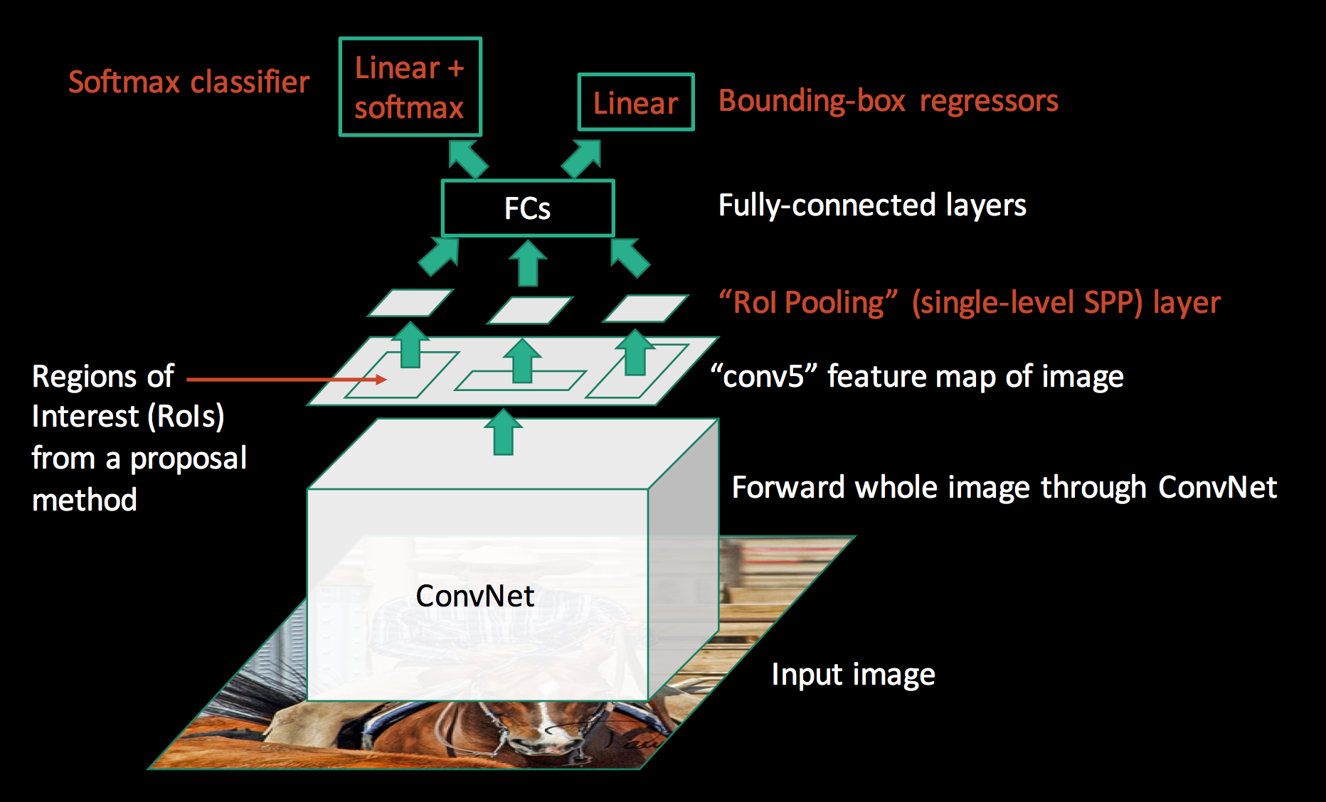
RCNN FAST RCNN

Slide 65
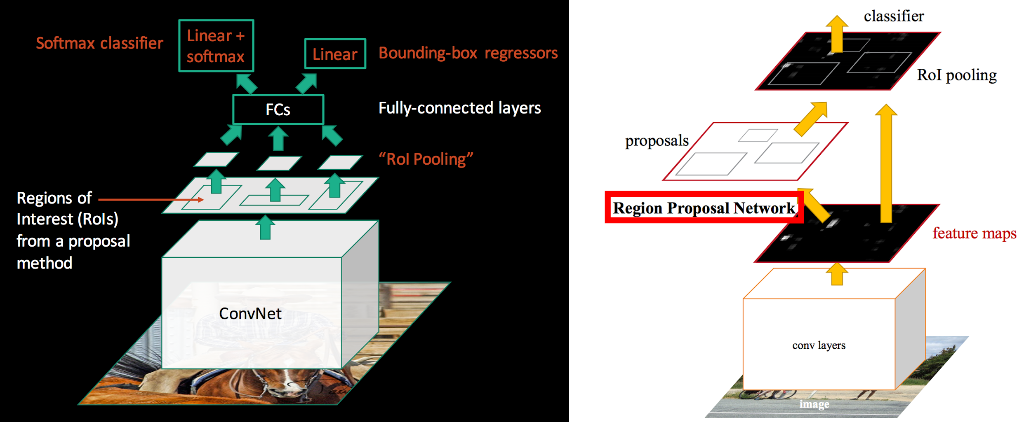

Slide 66
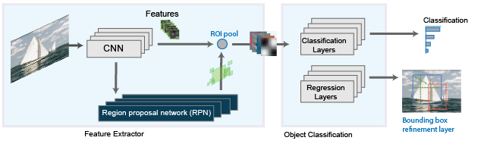
Faster R-CNN
The Faster R-CNN detector adds a region proposal network (RPN) to generate region proposals directly in the network instead of using an external algorithm like Edge Boxes. The RPN uses Anchor Boxes for Object Detection. Generating region proposals in the network is faster and better tuned to your data.

Slide 67
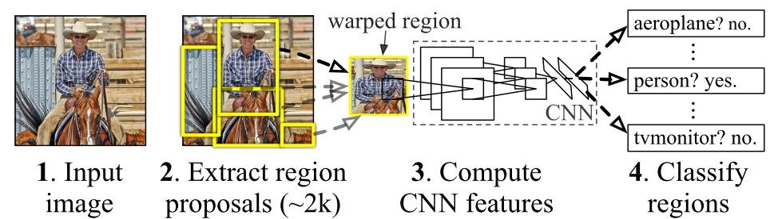
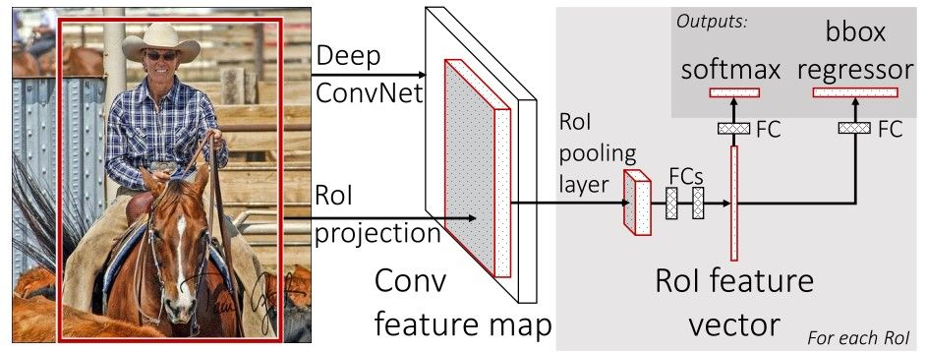

Slide 68
Faster R-CNN
The difference between Fast R-CNN and Faster R-CNN is that we do not use a special region proposal method to create region proposals.
Instead, we train a region proposal network that takes the feature maps as input and outputs region proposals.
These proposals are then feed into the RoI pooling layer in the Fast R-CNN.
The region proposal network is a convolution network.
The region proposal network uses the feature map of the “conv5” layer as input.
It slides a 3x3 spatial windows over the features maps with depth K.
For each sliding window, we output a vector with 256 features.
Those features are feed into 2 fully-connected networks to compute:
2 scores representing how likely it is an object or non-object/background.

Slide 69
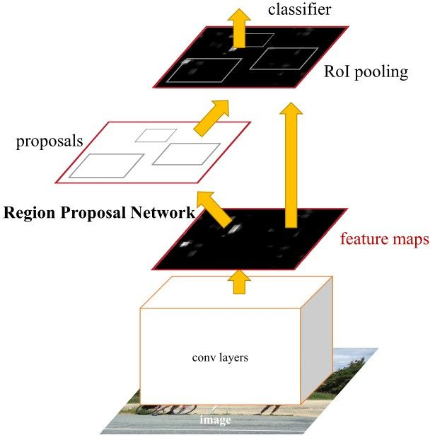
Faster RCNN

Slide 70
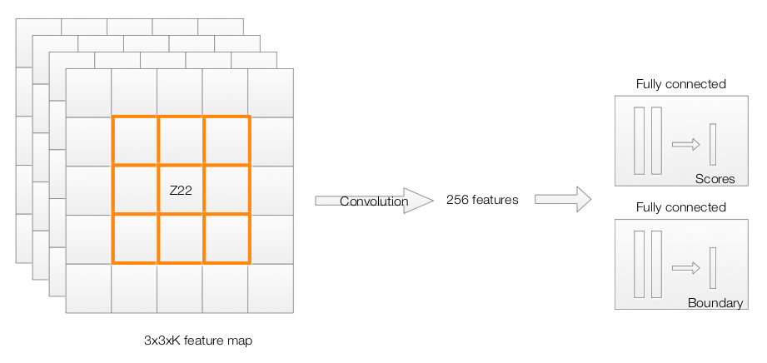

Slide 71
Intuition of Faster RCNN
Faster RCNN is the modified version of Fast RCNN.
The major difference between them is that Fast RCNN uses selective search for generating Regions of Interest, while Faster RCNN uses “Region Proposal Network”, aka RPN.
RPN takes image feature maps as an input and generates a set of object proposals, each with an objectness score as output.
The below steps are typically followed in a Faster RCNN approach:
We take an image as input and pass it to the ConvNet which returns the feature map for that image.
Region proposal network is applied on these feature maps. This returns the object proposals along with their objectness score.
A RoI pooling layer is applied on these proposals to bring down all the proposals to the same size.
Finally, the proposals are passed to a fully connected layer which has a softmax layer and a linear regression layer at its top, to classify and output the bounding boxes for objects.

Slide 72
Region Proposal Network (RPN)
The R-CNN and Fast R-CNN models depend on the Selective Search algorithm for generating region proposals. Each proposal is fed to a pre-trained CNN for classification.
The region proposal network (RPN) that can produce the region proposals. This has some advantages:
The region proposals are now generated using a network that could be trained and customized according to the detection task.
Because the proposals are generated using a network, this can be trained end-to-end to be customized on the detection task. Thus, it produces better region proposals compared to generic methods like Selective Search and EdgeBoxes.
The RPN processes the image using the same convolutional layers used in the Fast R-CNN detection network. Thus, the RPN does not take extra time to produce the proposals compared to the algorithms like Selective Search.
Due to sharing the same convolutional layers, the RPN and the Fast R-CNN can be merged/unified into a single network. Thus, training is done only once.

Slide 73
RPN
Let me briefly explain how this Region Proposal Network (RPN) actually works.
To begin with, Faster RCNN takes the feature maps from CNN and passes them on to the Region Proposal Network.
RPN uses a sliding window over these feature maps, and at each window, it generates k Anchor boxes of different shapes and sizes:

Slide 74
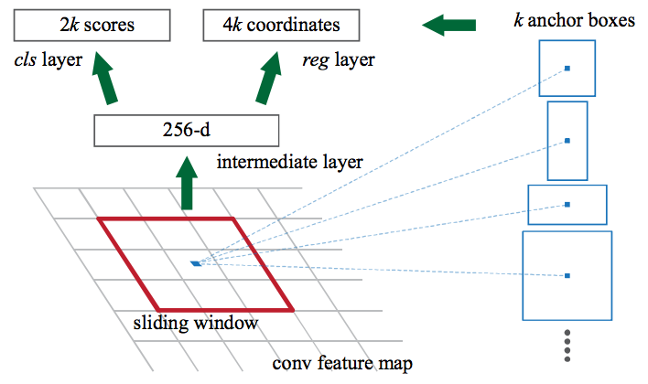

Slide 75
Anchor Box
Anchor boxes are fixed sized boundary boxes that are placed throughout the image and have different shapes and sizes.
For each anchor, RPN predicts two things:
The first is the probability that an anchor is an object (it does not consider which class the object belongs to)
Second is the bounding box regressor for adjusting the anchors to better fit the object
We now have bounding boxes of different shapes and sizes which are passed on to the RoI pooling layer.
Now it might be possible that after the RPN step, there are proposals with no classes assigned to them.
We can take each proposal and crop it so that each proposal contains an object.
This is what the RoI pooling layer does. It extracts fixed sized feature maps for each anchor:
Then these feature maps are passed to a fully connected layer which has a softmax and a linear regression layer.
It finally classifies the object and predicts the bounding boxes for the identified objects.

Slide 76
Problems with Faster RCNN
All of the object detection algorithms we have discussed so far use regions to identify the objects.
The network does not look at the complete image in one go, but focuses on parts of the image sequentially. This creates two complications:
The algorithm requires many passes through a single image to extract all the objects
As there are different systems working one after the other, the performance of the systems further ahead depends on how the previous systems performed

Slide 77
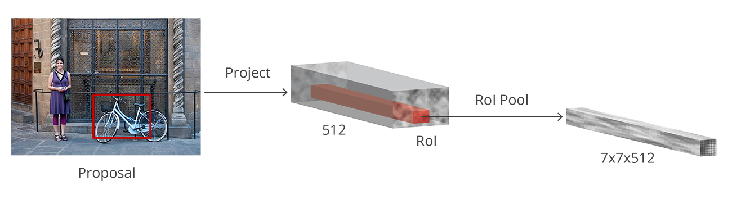

Slide 78
Algorithm | Features | Prediction time / image | Limitations
CNN | Divides the image into multiple regions and then classify each region into various classes. | – | Needs a lot of regions to predict accurately and hence high computation time.
RCNN | Uses selective search to generate regions. Extracts around 2000 regions from each image. | 40-50 seconds | High computation time as each region is passed to the CNN separately also it uses three different model for making predictions.
Fast RCNN | Each image is passed only once to the CNN and feature maps are extracted. Selective search is used on these maps to generate predictions. Combines all the three models used in RCNN together. | 2 seconds | Selective search is slow and hence computation time is still high.
Faster RCNN | Replaces the selective search method with region proposal network which made the algorithm much faster. | 0.2 seconds | Object proposal takes time and as there are different systems working one after the other, the performance of systems depends on how the previous system has performed.

